Slide 1
Women & African American’s role in WWII
EQ:
How did the roles of women and African Americans change during World War II?

Slide 2
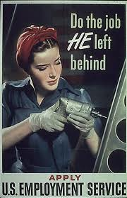
Women’s role
The role of women changed during World War II.
With so many men in the military, there were lots of businesses in need of workers!
Thousands of women went to work in jobs that had usually belonged to men.

Slide 3
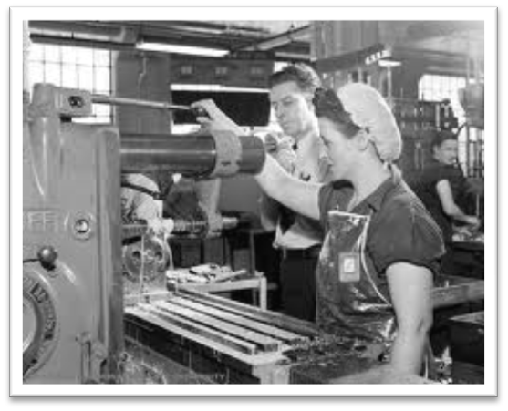
What kind of jobs?
They worked in places like:
  Farms
  Aircraft building factories
  shipyards
  office jobs
  joined the military
    Pilots
    Mechanics
    Truck drivers
    Office workers

Slide 4
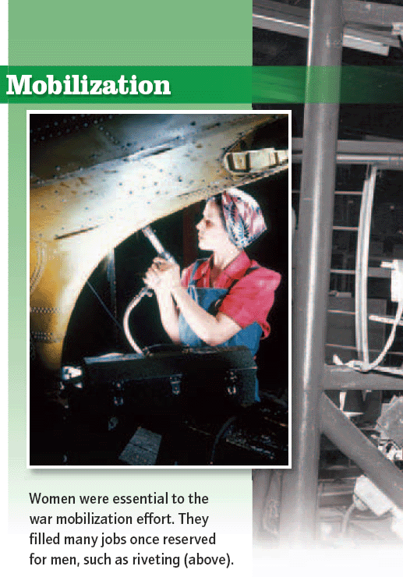
By the end of the war, 1/3 of the people working in U.S. business and industry were women
This was a BIG change in American life!

Slide 5
Rosie the Riveter
Rosie was a fictitious character appearing on government posters encouraging women to help in the war effort
A riveter is a person who inserts and hammers rivets, which are metal devices used to fasten parts together.
Rosie symbolized the many women working in factory jobs.

Slide 6

Rosie the Riveter

Slide 7
What would Rosie say?
“ We can do it! We can handle the tools and machines just like a guy!”
“I’d rather stay home than work in a dirty old defense plant.”
“Sign me up! I’m off to fight the Axis in Europe! I won’t come back till it’s over, over there!”

Slide 8
African Americans’ role
The need for workers during the war broke down some racial barriers and changed the roles of African Americans, too.
In both the North and South, African Americans began to get good jobs in places like steel mills and shipyards.

Slide 9
Tuskegee Airmen
One group of black men made quite a name for themselves in WWII.
The Tuskegee Airmen was a group of African American pilots trained at Tuskegee Institute in Alabama.
Because they were black, they were segregated from the white troops.
They also had to go through a difficult training program.

Slide 10

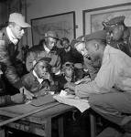
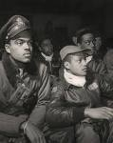


Slide 11
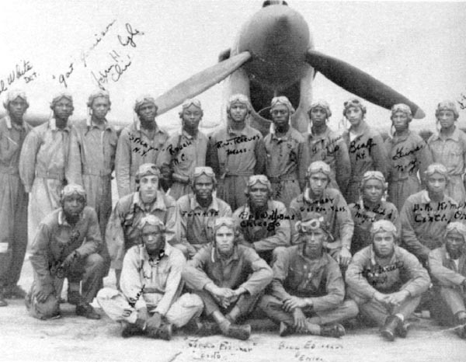
The Tuskegee Airmen is a group of African American pilots who flew alongside bombers to protect them.
Not one bomber was lost while being escorted by the Tuskegee Airmen!
No other squadron could make this claim during World War II.

Slide 12
